Slide 1
WELCOME TO MY MINI PROJECT ON (Emotion Based Music Player)

Slide 2
INTRODUCTION
Name->Jatin Thapliyal
Section-> D
Roll No-> 27
Id-> 20011827
Subject->Mini Project

Slide 3
What is Emotion Based Music Player
It is a player in which the user or person gets his face detected in the camera and tells us in what current mood the person is and according TO THAT MOOD HE/SHE GETS THE SONGS PLAYED FROM THE MUSIC PLAYER.

Slide 4
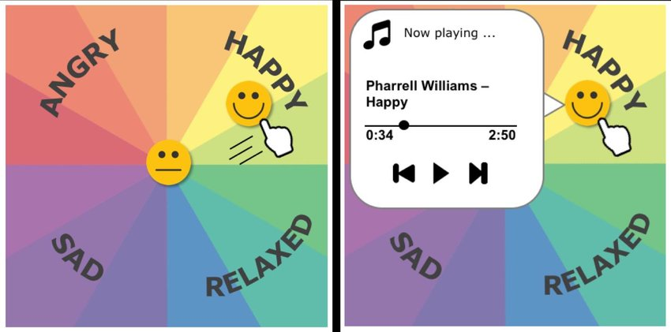
Working Model Of Project

Slide 5
Libraries
It is a collection of codes or modules that we can use in a program for specific operations.
1. Numpy->It is used for working with arrays. It also have functions for working in linear algebra, matrices.
2. RANDOM->it is a build in module in python which is used to generate random numbers, print random numbers and values.

Slide 6
3.WEBBROWSER->IT PROVIDES A HIGH-LEVEL INTERFACE THAT ALLOWS DISPLAYING WEB- BASED DOCUMENTS TO USERS.
4. CV2->IT IS DESIGNED TO SOLVE THE COMPUTER VISION PROBLEMS.IF A FILE DOES NOT LOAD A IMAGE THAN IT RETURNS A EMPTY MATRIX.

Slide 7
REQUIREMENTS
Hardware
Processor-> Intel(r)Core(Tm)i5-8265u @1.60ghz 1.80ghz
System type: 64-bit operating system,x64-based processor
Software
OPERATING SYSTEM: WINDOWS 10/linux
Language: python
Ide used: vscode
System bus: 32/64 bit
Ram: 256mb or more

Slide 8
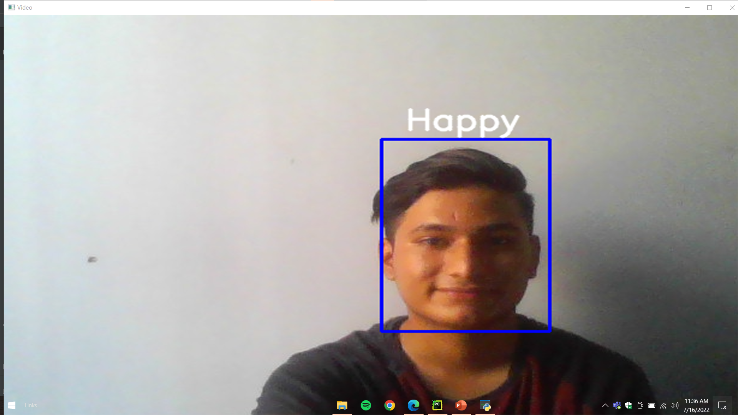
OUTPUT OF CODE

Slide 9
CONCLUSION
I have successfully implemented the emotion based music player project. In this player the image is captured and then analyses our emotion and according to our emotion or mood it will give or recommend us the songs and play it in the music player.

Slide 10
THANK YOU

